Slide 1
GRADE 7 ACCELERATED · UNIT 3
Exponents and Scientific Notation
Ten lessons in teaching order · the next slide jumps to each one
Grade 7 Accelerated · Unit 3 — Exponents and Scientific Notation
1

Slide 2
Contents
3.01
Product Laws of Exponents
slide 3
3.02
Quotient Laws of Exponents
slide 38
3.03
Exponential Expressions
slide 72
3.04
Negative Exponent Law
slide 106
3.05
Applying Exponent Laws
slide 140
3.06–07
Evaluating and Equivalent Expressions
slide 174
T-A1
Exponent Laws with Variable Bases
slide 209
T-A2
Negative Exponents with Variable Bases
slide 243
3.08
Writing Large Numbers in Scientific Notation
slide 277
3.09
Writing Small Numbers in Scientific Notation
slide 311
Grade 7 Accelerated · Unit 3 — Exponents and Scientific Notation
2

Slide 3
GRADE 7 ACCELERATED · UNIT 3 · LESSON 1
Product Laws of Exponents
MA.7.NSO.1.1
I can use the product of powers, power of a product, power of a power and identity laws to rewrite and evaluate a numerical expression.
Grade 7 Accelerated · Unit 3 · Lesson 1 — Product Laws of Exponents
1

Slide 4
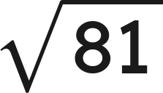
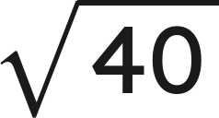

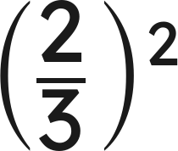
Warm-Up
1.
2. Between which two whole numbers is
?
3. Solve
4. Evaluate
Grade 7 Accelerated · Unit 3 · Lesson 1 — Product Laws of Exponents
2

Slide 5

Warm-Up
1.
9
2. Between which two whole numbers is
?
6 and 7
3. Solve
x = 6
4. Evaluate
Grade 7 Accelerated · Unit 3 · Lesson 1 — Product Laws of Exponents
3

Slide 6
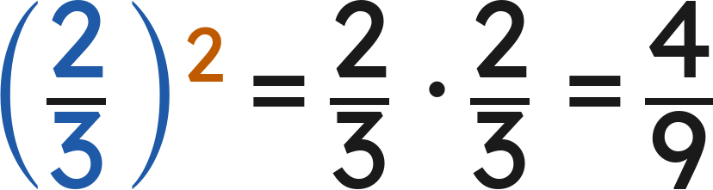

Notes
I. A power is a shorthand for repeated multiplication
A.
base — the number used as a factor
B.
exponent — how many times the base is a factor
C.
power — the whole thing, base and exponent together
Grade 7 Accelerated · Unit 3 · Lesson 1 — Product Laws of Exponents
4

Slide 7
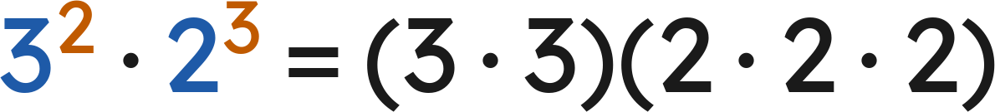

Notes
II. Product of powers — same base, add the exponents
— different bases, no shortcut
Product of powers:
Check with values:
Grade 7 Accelerated · Unit 3 · Lesson 1 — Product Laws of Exponents
5

Slide 8

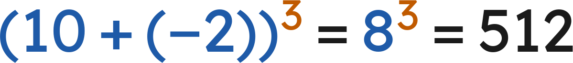
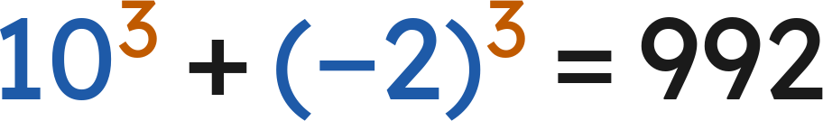
Notes
III. Power of a product — the exponent goes to every factor
Power of a product:
Works for a product only, never for a sum:
but
Grade 7 Accelerated · Unit 3 · Lesson 1 — Product Laws of Exponents
6

Slide 9


Notes
IV. Power of a power, and the exponent 1
Power of a power | Repeated multiplication | Single power
(4²)³ | 4² · 4² · 4² | 4⁶
(10⁴)⁴ | 10⁴ · 10⁴ · 10⁴ · 10⁴ | 10¹⁶
(3¹)⁵ | 3 · 3 · 3 · 3 · 3 | 3⁵
Power of a power:
Identity:
Grade 7 Accelerated · Unit 3 · Lesson 1 — Product Laws of Exponents
7

Slide 10

Example 1
Which law? Then find the value.
Grade 7 Accelerated · Unit 3 · Lesson 1 — Product Laws of Exponents
8

Slide 11

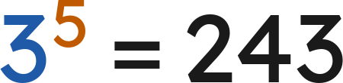

Example 1
Answer: 243
Grade 7 Accelerated · Unit 3 · Lesson 1 — Product Laws of Exponents
9

Slide 12

Your Turn
Which law? Then find the value.
Grade 7 Accelerated · Unit 3 · Lesson 1 — Product Laws of Exponents
10

Slide 13



Your Turn
Which law? Then find the value.
Answer: 2⁷ = 128
Grade 7 Accelerated · Unit 3 · Lesson 1 — Product Laws of Exponents
11

Slide 14
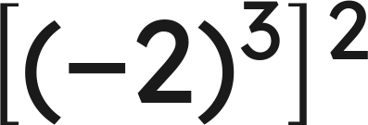
Example 2
Which law? Then find the value.
Grade 7 Accelerated · Unit 3 · Lesson 1 — Product Laws of Exponents
12

Slide 15

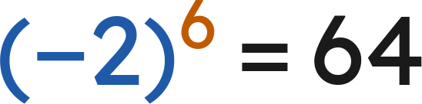
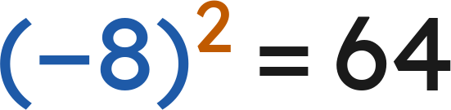
Example 2
Answer: 64
Grade 7 Accelerated · Unit 3 · Lesson 1 — Product Laws of Exponents
13

Slide 16
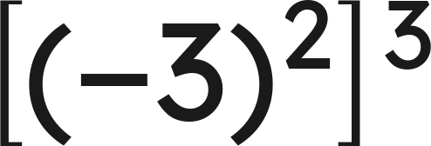
Your Turn
Which law? Then find the value.
Grade 7 Accelerated · Unit 3 · Lesson 1 — Product Laws of Exponents
14

Slide 17


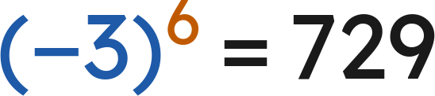
Your Turn
Which law? Then find the value.
Answer: (−3)⁶ = 729
Grade 7 Accelerated · Unit 3 · Lesson 1 — Product Laws of Exponents
15

Slide 18
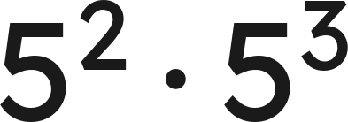
Whiteboards · Question 1 of 9
Answer it.
Grade 7 Accelerated · Unit 3 · Lesson 1 — Product Laws of Exponents
16

Slide 19



Whiteboards · Question 1 of 9
Answer:
Grade 7 Accelerated · Unit 3 · Lesson 1 — Product Laws of Exponents
17

Slide 20


Whiteboards · Question 2 of 9
A rectangle is
centimeters long and
centimeters wide.
Its perimeter is 40 centimeters.
What is the area of the rectangle, in square centimeters?
Answer it.
Grade 7 Accelerated · Unit 3 · Lesson 1 — Product Laws of Exponents
18

Slide 21




Whiteboards · Question 2 of 9
A rectangle is
centimeters long and
centimeters wide.
Its perimeter is 40 centimeters.
What is the area of the rectangle, in square centimeters?
Area = length × width
Answer: 2⁶ = 64 square centimeters
Grade 7 Accelerated · Unit 3 · Lesson 1 — Product Laws of Exponents
19

Slide 22
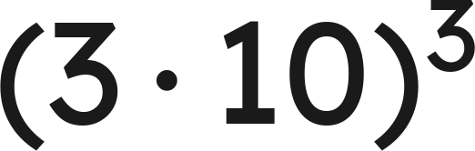
Whiteboards · Question 3 of 9
Answer it.
Grade 7 Accelerated · Unit 3 · Lesson 1 — Product Laws of Exponents
20

Slide 23

Whiteboards · Question 3 of 9
Answer: 27,000
Grade 7 Accelerated · Unit 3 · Lesson 1 — Product Laws of Exponents
21

Slide 24
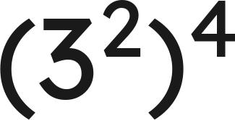
Whiteboards · Question 4 of 9
Answer it.
Grade 7 Accelerated · Unit 3 · Lesson 1 — Product Laws of Exponents
22

Slide 25
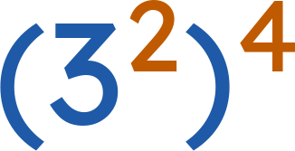


Whiteboards · Question 4 of 9
Answer:
Grade 7 Accelerated · Unit 3 · Lesson 1 — Product Laws of Exponents
23

Slide 26
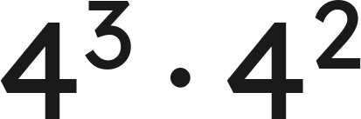
Whiteboards · Question 5 of 9
Which expression is equivalent?
A. 16⁵
B. 8⁵
C. 4⁶
D. 4⁵
Answer it.
Grade 7 Accelerated · Unit 3 · Lesson 1 — Product Laws of Exponents
24

Slide 27
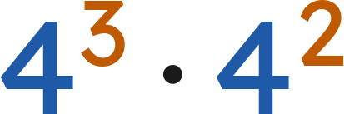

Whiteboards · Question 5 of 9
Which expression is equivalent?
Answer: D — 4⁵
Grade 7 Accelerated · Unit 3 · Lesson 1 — Product Laws of Exponents
25

Slide 28
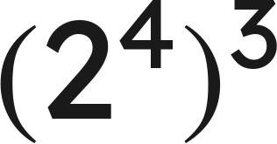
Whiteboards · Question 6 of 9
Which expression is equivalent?
A. 2⁷
B. 8¹²
C. 2¹²
D. 2⁶⁴
Answer it.
Grade 7 Accelerated · Unit 3 · Lesson 1 — Product Laws of Exponents
26

Slide 29
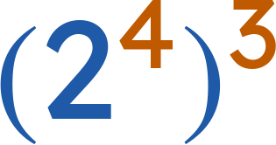
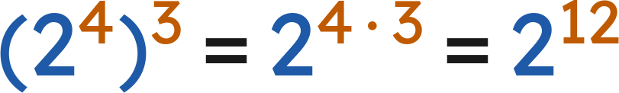
Whiteboards · Question 6 of 9
Which expression is equivalent?
Answer: C — 2¹²
Grade 7 Accelerated · Unit 3 · Lesson 1 — Product Laws of Exponents
27

Slide 30
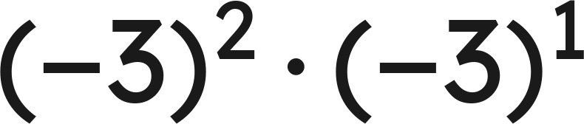
Whiteboards · Question 7 of 9
Answer it.
Grade 7 Accelerated · Unit 3 · Lesson 1 — Product Laws of Exponents
28

Slide 31
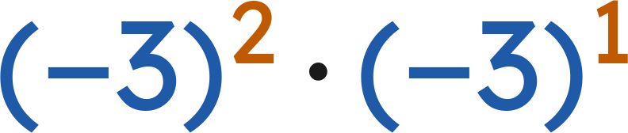
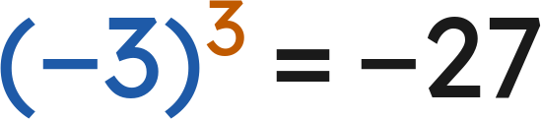
Whiteboards · Question 7 of 9
Answer: −27
Grade 7 Accelerated · Unit 3 · Lesson 1 — Product Laws of Exponents
29

Slide 32
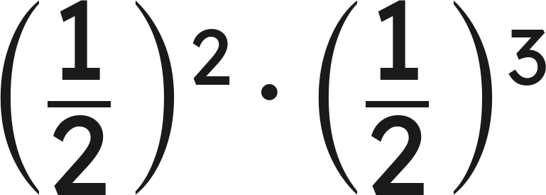
Whiteboards · Question 8 of 9
Answer it.
Grade 7 Accelerated · Unit 3 · Lesson 1 — Product Laws of Exponents
30

Slide 33
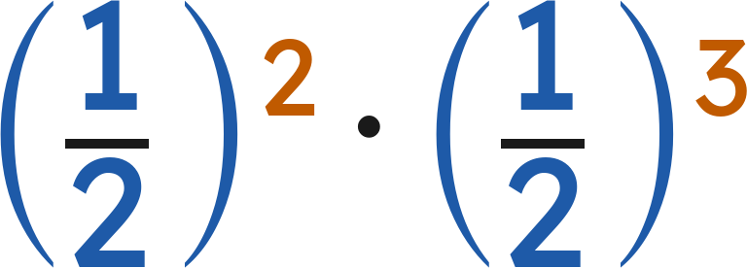
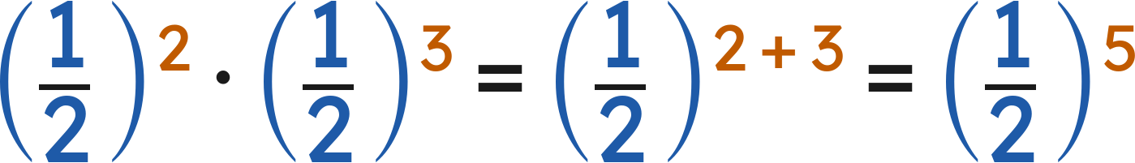
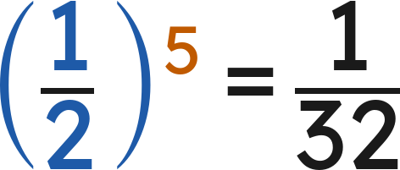

Whiteboards · Question 8 of 9
Answer:
Grade 7 Accelerated · Unit 3 · Lesson 1 — Product Laws of Exponents
31

Slide 34
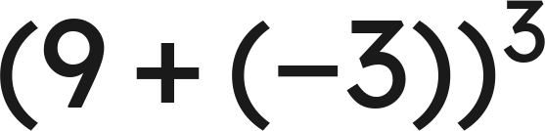
Whiteboards · Question 9 of 9
Aiyanna says she can use the power of a product law
to evaluate
. Is she right?
Write your answer in sentences.
Grade 7 Accelerated · Unit 3 · Lesson 1 — Product Laws of Exponents
32

Slide 35



Whiteboards · Question 9 of 9
Aiyanna says she can use the power of a product law
to evaluate
. Is she right?
Inside the parentheses is a sum, not a product.
Answer: No — (9 + (−3))³ = 6³ = 216
Grade 7 Accelerated · Unit 3 · Lesson 1 — Product Laws of Exponents
33

Slide 36


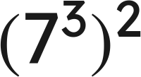
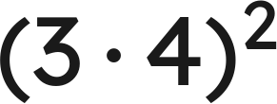
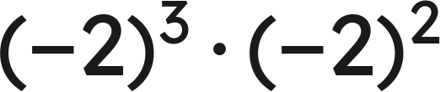


Independent Set
1.
Write as one power.
2.
Find the value.
3.
Write as one power.
4.
Find the value.
5.
Find the value.
6.
Find the value of
.
Grade 7 Accelerated · Unit 3 · Lesson 1 — Product Laws of Exponents
34

Slide 37
IXL
1.
Open IXL and start today's skills.
2.
Work on paper where the question needs work. The answer box does not show it.
3.
Every skill listed is required, to a SmartScore of 67. Due at the start of the next class.
Today's skills — all required
Evaluate powers — SZQ
Multiplication with exponents — 5SK
Power rule — 8DA
Understanding exponents — BFA
Grade 7 Accelerated · Unit 3 · Lesson 1 — Product Laws of Exponents
35

Slide 38
GRADE 7 ACCELERATED · UNIT 3 · LESSON 2
Quotient Laws of Exponents
MA.7.NSO.1.1
I can use the quotient of powers, power of a quotient and zero exponent laws to rewrite and evaluate a numerical expression.
Grade 7 Accelerated · Unit 3 · Lesson 2 — Quotient Laws of Exponents
1

Slide 39

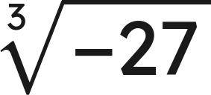

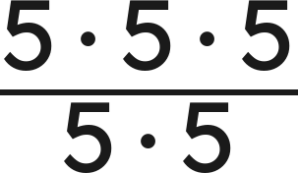
Warm-Up
1. Write as one power:
2.
3. Solve
4. Simplify
Grade 7 Accelerated · Unit 3 · Lesson 2 — Quotient Laws of Exponents
2

Slide 40

Warm-Up
1. Write as one power:
2.
−3
3. Solve
x < 4
4. Simplify
5
Grade 7 Accelerated · Unit 3 · Lesson 2 — Quotient Laws of Exponents
3

Slide 41
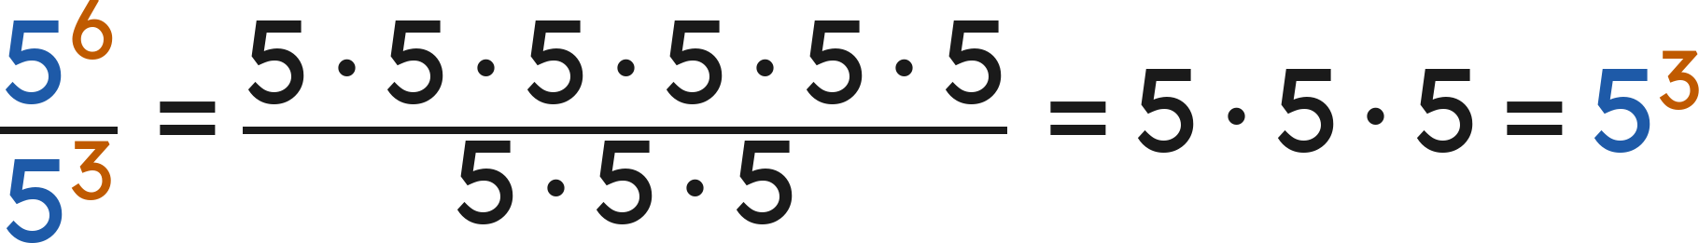
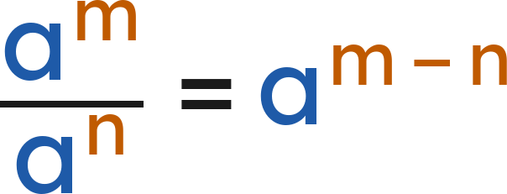

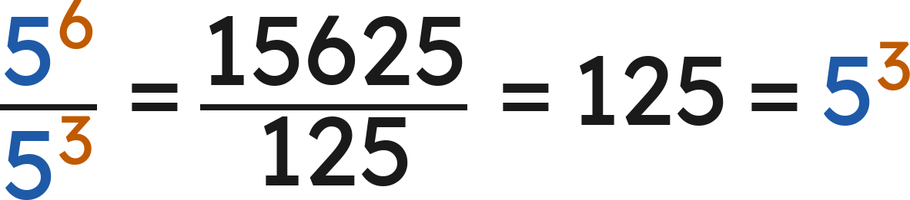
Notes
I. Quotient of powers — same base, subtract the exponents
Quotient of powers:
(
)
Check with values:
Grade 7 Accelerated · Unit 3 · Lesson 2 — Quotient Laws of Exponents
4

Slide 42
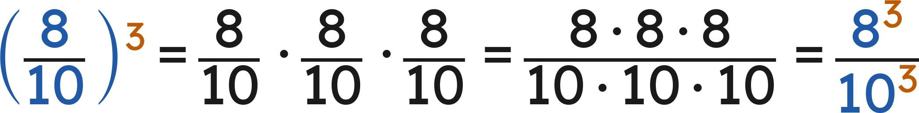
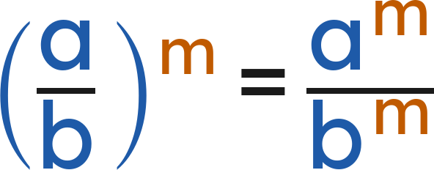

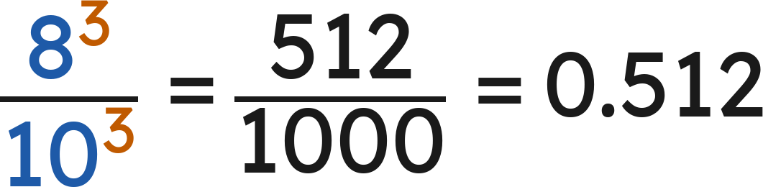
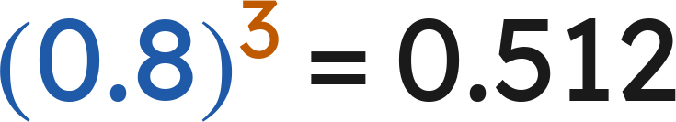
Notes
II. Power of a quotient — the exponent goes top and bottom
Power of a quotient:
(
)
Either way:
and
Grade 7 Accelerated · Unit 3 · Lesson 2 — Quotient Laws of Exponents
5

Slide 43
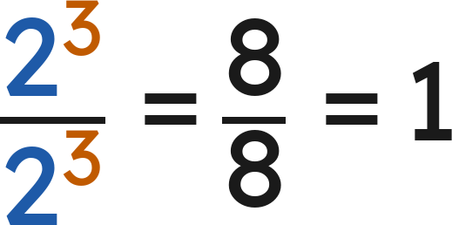
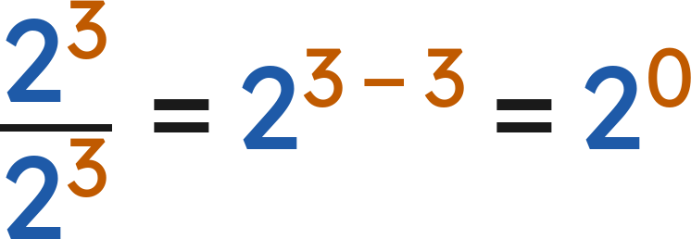
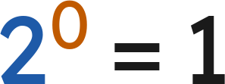
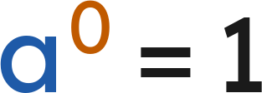

Notes
III. The zero exponent — two roads to the same answer
2⁴ | 2³ | 2² | 2¹ | 2⁰
16 | 8 | 4 | 2 | 1
and
so
Zero exponent:
for every nonzero
Grade 7 Accelerated · Unit 3 · Lesson 2 — Quotient Laws of Exponents
6

Slide 44
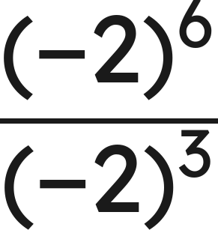
Example 1
Which law? Then find the value.
Grade 7 Accelerated · Unit 3 · Lesson 2 — Quotient Laws of Exponents
7

Slide 45
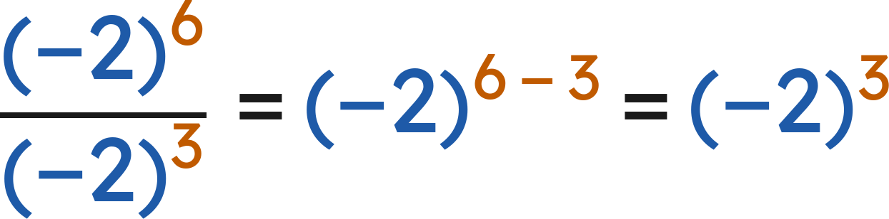
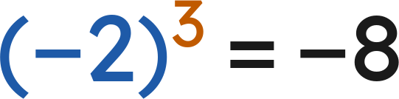
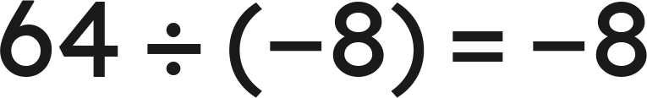
Example 1
Answer: −8
Grade 7 Accelerated · Unit 3 · Lesson 2 — Quotient Laws of Exponents
8

Slide 46

Your Turn
Which law? Then find the value.
Grade 7 Accelerated · Unit 3 · Lesson 2 — Quotient Laws of Exponents
9

Slide 47



Your Turn
Which law? Then find the value.
Answer: 3⁴ = 81
Grade 7 Accelerated · Unit 3 · Lesson 2 — Quotient Laws of Exponents
10

Slide 48

Example 2
Find the value.
Grade 7 Accelerated · Unit 3 · Lesson 2 — Quotient Laws of Exponents
11

Slide 49



Example 2
Answer: 0.00000016
Grade 7 Accelerated · Unit 3 · Lesson 2 — Quotient Laws of Exponents
12

Slide 50

Your Turn
Find the value.
Grade 7 Accelerated · Unit 3 · Lesson 2 — Quotient Laws of Exponents
13

Slide 51



Your Turn
Find the value.
Answer:
Grade 7 Accelerated · Unit 3 · Lesson 2 — Quotient Laws of Exponents
14

Slide 52

Whiteboards · Question 1 of 9
Answer it.
Grade 7 Accelerated · Unit 3 · Lesson 2 — Quotient Laws of Exponents
15

Slide 53



Whiteboards · Question 1 of 9
Answer:
Grade 7 Accelerated · Unit 3 · Lesson 2 — Quotient Laws of Exponents
16

Slide 54

Whiteboards · Question 2 of 9
A website puts
photos into 7 equal albums.
The site is 30 days old.
How many photos are in each album?
Answer it.
Grade 7 Accelerated · Unit 3 · Lesson 2 — Quotient Laws of Exponents
17

Slide 55



Whiteboards · Question 2 of 9
A website puts
photos into 7 equal albums.
The site is 30 days old.
How many photos are in each album?
Answer: 343
Grade 7 Accelerated · Unit 3 · Lesson 2 — Quotient Laws of Exponents
18

Slide 56

Whiteboards · Question 3 of 9
Answer it.
Grade 7 Accelerated · Unit 3 · Lesson 2 — Quotient Laws of Exponents
19

Slide 57


Whiteboards · Question 3 of 9
Answer: −6
Grade 7 Accelerated · Unit 3 · Lesson 2 — Quotient Laws of Exponents
20

Slide 58

Whiteboards · Question 4 of 9
Answer it.
Grade 7 Accelerated · Unit 3 · Lesson 2 — Quotient Laws of Exponents
21

Slide 59



Whiteboards · Question 4 of 9
Answer:
Grade 7 Accelerated · Unit 3 · Lesson 2 — Quotient Laws of Exponents
22

Slide 60

Whiteboards · Question 5 of 9
Which is the value?
A. 1
B. 9
C. 1/9
D. 0
Answer it.
Grade 7 Accelerated · Unit 3 · Lesson 2 — Quotient Laws of Exponents
23

Slide 61


Whiteboards · Question 5 of 9
Which is the value?
Any nonzero number to the power 0 is 1.
Answer: A — 1
Grade 7 Accelerated · Unit 3 · Lesson 2 — Quotient Laws of Exponents
24

Slide 62

Whiteboards · Question 6 of 9
Which expression is equivalent?
A. 1⁶
B. 4¹⁰
C. 4⁶
D. 4⁴
Answer it.
Grade 7 Accelerated · Unit 3 · Lesson 2 — Quotient Laws of Exponents
25

Slide 63


Whiteboards · Question 6 of 9
Which expression is equivalent?
Answer: C — 4⁶
Grade 7 Accelerated · Unit 3 · Lesson 2 — Quotient Laws of Exponents
26

Slide 64

Whiteboards · Question 7 of 9
Answer it.
Grade 7 Accelerated · Unit 3 · Lesson 2 — Quotient Laws of Exponents
27

Slide 65



Whiteboards · Question 7 of 9
Answer: 0.125
Grade 7 Accelerated · Unit 3 · Lesson 2 — Quotient Laws of Exponents
28

Slide 66

Whiteboards · Question 8 of 9
Answer it.
Grade 7 Accelerated · Unit 3 · Lesson 2 — Quotient Laws of Exponents
29

Slide 67


Whiteboards · Question 8 of 9
Any nonzero number to the power 0 is 1.
Answer: 1
Grade 7 Accelerated · Unit 3 · Lesson 2 — Quotient Laws of Exponents
30

Slide 68


Whiteboards · Question 9 of 9
Hannah cancels:
. Sebastian subtracts:
.
Who is right?
Write your answer in sentences.
Grade 7 Accelerated · Unit 3 · Lesson 2 — Quotient Laws of Exponents
31

Slide 69





Whiteboards · Question 9 of 9
Hannah cancels:
. Sebastian subtracts:
.
Who is right?
Hannah:
Sebastian:
Same fraction, so
Answer: Both — 6⁰ = 1
Grade 7 Accelerated · Unit 3 · Lesson 2 — Quotient Laws of Exponents
32

Slide 70






Independent Set
1.
Write as one power.
2.
Find the value.
3.
Find the value.
4.
Rewrite so the exponent is on the numerator and on the denominator.
5.
Find the value.
6.
Find the value of
.
Grade 7 Accelerated · Unit 3 · Lesson 2 — Quotient Laws of Exponents
33

Slide 71
IXL
1.
Open IXL and start today's skills.
2.
Work on paper where the question needs work. The answer box does not show it.
3.
Every skill listed is required, to a SmartScore of 67. Due at the start of the next class.
Today's skills — all required
Powers with negative bases — WFW
Division with exponents — XNC
Identify equivalent expressions involving whole-number exponents — KBE
Grade 7 Accelerated · Unit 3 · Lesson 2 — Quotient Laws of Exponents
34

Slide 72
GRADE 7 ACCELERATED · UNIT 3 · LESSON 3
Exponential Expressions
MA.7.NSO.1.1
I can apply more than one law of exponents to evaluate an expression and to write an equivalent one.
Grade 7 Accelerated · Unit 3 · Lesson 3 — Exponential Expressions
1

Slide 73




Warm-Up
1. Find the value:
2. Is
closer to 7 or to 8?
3. Solve
4. Evaluate
Grade 7 Accelerated · Unit 3 · Lesson 3 — Exponential Expressions
2

Slide 74
Warm-Up
1. Find the value:
100
2. Is
closer to 7 or to 8?
7
3. Solve
x = 5
4. Evaluate
50
Grade 7 Accelerated · Unit 3 · Lesson 3 — Exponential Expressions
3

Slide 75
Notes
I. The seven laws, in one place
Law | Rule | Example
Product of powers | a^{m} · a^{n} = a^{m+n} | 2³ · 2¹ = 2⁴
Quotient of powers | a^{m} ÷ a^{n} = a^{m-n} | (−3)⁷ ÷ (−3)² = (−3)⁵
Power of a product | (ab)^{m} = a^{m} · b^{m} | (−7 · 3)² = (−7)² · 3²
Power of a quotient | (a ÷ b)^{m} = a^{m} ÷ b^{m} | (13 ÷ 5)³ = 13³ ÷ 5³
Power of a power | (a^{m})^{n} = a^{mn} | (6³)⁴ = 6¹²
Identity exponent | a¹ = a | 15¹ = 15
Zero exponent | a⁰ = 1 | 127⁰ = 1
Grade 7 Accelerated · Unit 3 · Lesson 3 — Exponential Expressions
4

Slide 76


Notes
II. More than one law — make a plan, then follow it
Winston:
Yvette:
Different plans, same value. Any correct sequence of laws gives the same answer.
Grade 7 Accelerated · Unit 3 · Lesson 3 — Exponential Expressions
5

Slide 77


Notes
III. Order of operations still applies
A.
Parentheses first — including a fraction bar, which is a pair of parentheses in disguise.
B.
Exponents next — the laws of exponents are applied here.
C.
Then multiply and divide, left to right; then add and subtract.
D.
Never across a + or a −:
, not
.
Grade 7 Accelerated · Unit 3 · Lesson 3 — Exponential Expressions
6

Slide 78

Example 1
Make a plan. Then find the value.
Grade 7 Accelerated · Unit 3 · Lesson 3 — Exponential Expressions
7

Slide 79



Example 1
Answer: 64
Grade 7 Accelerated · Unit 3 · Lesson 3 — Exponential Expressions
8

Slide 80

Your Turn
Make a plan. Then find the value.
Grade 7 Accelerated · Unit 3 · Lesson 3 — Exponential Expressions
9

Slide 81




Your Turn
Make a plan. Then find the value.
, so the top is
Answer: 5² = 25
Grade 7 Accelerated · Unit 3 · Lesson 3 — Exponential Expressions
10

Slide 82

Example 2
Make a plan. Then find the value.
Grade 7 Accelerated · Unit 3 · Lesson 3 — Exponential Expressions
11

Slide 83



Example 2
Answer: 10,000
Grade 7 Accelerated · Unit 3 · Lesson 3 — Exponential Expressions
12

Slide 84

Your Turn
Make a plan. Then find the value.
Grade 7 Accelerated · Unit 3 · Lesson 3 — Exponential Expressions
13

Slide 85



Your Turn
Make a plan. Then find the value.
Answer: −27
Grade 7 Accelerated · Unit 3 · Lesson 3 — Exponential Expressions
14

Slide 86


Whiteboards · Question 1 of 9
A warehouse holds
boxes in
equal rows.
Each box weighs 3 kilograms.
How many boxes are in each row?
Answer it.
Grade 7 Accelerated · Unit 3 · Lesson 3 — Exponential Expressions
15

Slide 87




Whiteboards · Question 1 of 9
A warehouse holds
boxes in
equal rows.
Each box weighs 3 kilograms.
How many boxes are in each row?
Answer: 36
Grade 7 Accelerated · Unit 3 · Lesson 3 — Exponential Expressions
16

Slide 88

Whiteboards · Question 2 of 9
Answer it.
Grade 7 Accelerated · Unit 3 · Lesson 3 — Exponential Expressions
17

Slide 89



Whiteboards · Question 2 of 9
Inside first:
Answer: 729
Grade 7 Accelerated · Unit 3 · Lesson 3 — Exponential Expressions
18

Slide 90

Whiteboards · Question 3 of 9
Answer it.
Grade 7 Accelerated · Unit 3 · Lesson 3 — Exponential Expressions
19

Slide 91



Whiteboards · Question 3 of 9
Top:
Answer: 0.0625
Grade 7 Accelerated · Unit 3 · Lesson 3 — Exponential Expressions
20

Slide 92

Whiteboards · Question 4 of 9
Answer it.
Grade 7 Accelerated · Unit 3 · Lesson 3 — Exponential Expressions
21

Slide 93



Whiteboards · Question 4 of 9
Answer: 6.25
Grade 7 Accelerated · Unit 3 · Lesson 3 — Exponential Expressions
22

Slide 94

Whiteboards · Question 5 of 9
Which is the value?
A. 1/4
B. 2²²
C. 0
D. 4
Answer it.
Grade 7 Accelerated · Unit 3 · Lesson 3 — Exponential Expressions
23

Slide 95




Whiteboards · Question 5 of 9
Which is the value?
, so the top is
Answer: D — 4
Grade 7 Accelerated · Unit 3 · Lesson 3 — Exponential Expressions
24

Slide 96

Whiteboards · Question 6 of 9
Which expression is equivalent?
A. 0.2⁰ · 0.1²
B. 0.2³ · 0.1²
C. 0.1⁵
D. 0.1⁶
Answer it.
Grade 7 Accelerated · Unit 3 · Lesson 3 — Exponential Expressions
25

Slide 97


Whiteboards · Question 6 of 9
Which expression is equivalent?
Answer: C — 0.1⁵
Grade 7 Accelerated · Unit 3 · Lesson 3 — Exponential Expressions
26

Slide 98

Whiteboards · Question 7 of 9
Answer it.
Grade 7 Accelerated · Unit 3 · Lesson 3 — Exponential Expressions
27

Slide 99


Whiteboards · Question 7 of 9
Answer: 0.0001
Grade 7 Accelerated · Unit 3 · Lesson 3 — Exponential Expressions
28

Slide 100

Whiteboards · Question 8 of 9
Answer it.
Grade 7 Accelerated · Unit 3 · Lesson 3 — Exponential Expressions
29

Slide 101



Whiteboards · Question 8 of 9
Top:
Bottom:
Answer: −64
Grade 7 Accelerated · Unit 3 · Lesson 3 — Exponential Expressions
30

Slide 102


Whiteboards · Question 9 of 9
Winston writes
. Yvette writes
.
Do they get the same value? Explain.
Write your answer in sentences.
Grade 7 Accelerated · Unit 3 · Lesson 3 — Exponential Expressions
31

Slide 103





Whiteboards · Question 9 of 9
Winston writes
. Yvette writes
.
Do they get the same value? Explain.
Winston:
Yvette:
Answer: Yes — both give 4⁶ = 4,096
Grade 7 Accelerated · Unit 3 · Lesson 3 — Exponential Expressions
32

Slide 104







Independent Set
1.
Find the value.
2.
Find the value.
3.
Write as one power.
4.
Find the value.
5.
Find the value.
6.
Show that
and
have the same value.
Grade 7 Accelerated · Unit 3 · Lesson 3 — Exponential Expressions
33

Slide 105
IXL
1.
Open IXL and start today's skills.
2.
Work on paper where the question needs work. The answer box does not show it.
3.
Every skill listed is required, to a SmartScore of 67. Due at the start of the next class.
Today's skills — all required
Evaluate expressions using properties of exponents — ZE9
Grade 7 Accelerated · Unit 3 · Lesson 3 — Exponential Expressions
34

Slide 106
GRADE 7 ACCELERATED · UNIT 3 · LESSON 4
Negative Exponent Law
MA.8.NSO.1.3
I can rewrite a power with a negative exponent using a positive exponent, and evaluate it.
Grade 7 Accelerated · Unit 3 · Lesson 4 — Negative Exponent Law
1

Slide 107




Warm-Up
1. Find the value:
2. Which is greater,
or 5.5?
3. Solve
4. What is the reciprocal of
? What is the opposite of
?
Grade 7 Accelerated · Unit 3 · Lesson 4 — Negative Exponent Law
2

Slide 108


Warm-Up
1. Find the value:
25
2. Which is greater,
or 5.5?
5.5
3. Solve
x = −7
4. What is the reciprocal of
? What is the opposite of
?
and
Grade 7 Accelerated · Unit 3 · Lesson 4 — Negative Exponent Law
3

Slide 109



Notes
I. The pattern keeps going past zero
2⁴ | 2³ | 2² | 2¹ | 2⁰ | 2⁻¹ | 2⁻² | 2⁻³
16 | 8 | 4 | 2 | 1 | 1/2 | 1/4 | 1/8
Grade 7 Accelerated · Unit 3 · Lesson 4 — Negative Exponent Law
4

Slide 110






Notes
II. The negative exponent law
(
)
but
and
A negative exponent means reciprocal. It never means a negative value.
The base keeps its own sign:
Grade 7 Accelerated · Unit 3 · Lesson 4 — Negative Exponent Law
5

Slide 111


Notes
III. The laws still work with negative exponents
or
Add, subtract and multiply exponents exactly as before — the exponents are just integers now.
Grade 7 Accelerated · Unit 3 · Lesson 4 — Negative Exponent Law
6

Slide 112

Example 1
Rewrite with positive exponents, then find the value.
Grade 7 Accelerated · Unit 3 · Lesson 4 — Negative Exponent Law
7

Slide 113


Example 1
Answer: 81/8 = 10.125
Grade 7 Accelerated · Unit 3 · Lesson 4 — Negative Exponent Law
8

Slide 114

Your Turn
Rewrite with positive exponents, then find the value.
Grade 7 Accelerated · Unit 3 · Lesson 4 — Negative Exponent Law
9

Slide 115





Your Turn
Rewrite with positive exponents, then find the value.
and
Answer:
Grade 7 Accelerated · Unit 3 · Lesson 4 — Negative Exponent Law
10

Slide 116

Example 2
Find the value.
Grade 7 Accelerated · Unit 3 · Lesson 4 — Negative Exponent Law
11

Slide 117



Example 2
Answer: 2,401
Grade 7 Accelerated · Unit 3 · Lesson 4 — Negative Exponent Law
12

Slide 118

Your Turn
Find the value.
Grade 7 Accelerated · Unit 3 · Lesson 4 — Negative Exponent Law
13

Slide 119



Your Turn
Find the value.
Answer: 64
Grade 7 Accelerated · Unit 3 · Lesson 4 — Negative Exponent Law
14

Slide 120

Whiteboards · Question 1 of 9
Answer it.
Grade 7 Accelerated · Unit 3 · Lesson 4 — Negative Exponent Law
15

Slide 121



Whiteboards · Question 1 of 9
Answer:
Grade 7 Accelerated · Unit 3 · Lesson 4 — Negative Exponent Law
16

Slide 122
Whiteboards · Question 2 of 9
A sheet of paper 30 centimeters long is folded in half 7 times.
Each fold makes the top layer half as big.
What fraction of the whole sheet is the top layer after 7 folds?
Answer it.
Grade 7 Accelerated · Unit 3 · Lesson 4 — Negative Exponent Law
17

Slide 123



Whiteboards · Question 2 of 9
A sheet of paper 30 centimeters long is folded in half 7 times.
Each fold makes the top layer half as big.
What fraction of the whole sheet is the top layer after 7 folds?
Each fold halves it:
, so
Answer:
Grade 7 Accelerated · Unit 3 · Lesson 4 — Negative Exponent Law
18

Slide 124

Whiteboards · Question 3 of 9
Answer it.
Grade 7 Accelerated · Unit 3 · Lesson 4 — Negative Exponent Law
19

Slide 125



Whiteboards · Question 3 of 9
Answer: 10² = 100
Grade 7 Accelerated · Unit 3 · Lesson 4 — Negative Exponent Law
20

Slide 126

Whiteboards · Question 4 of 9
Answer it.
Grade 7 Accelerated · Unit 3 · Lesson 4 — Negative Exponent Law
21

Slide 127




Whiteboards · Question 4 of 9
, so
Answer:
Grade 7 Accelerated · Unit 3 · Lesson 4 — Negative Exponent Law
22

Slide 128

Whiteboards · Question 5 of 9
Which is the value?
A. 1/14
B. 1/49
C. −49
D. −14
Answer it.
Grade 7 Accelerated · Unit 3 · Lesson 4 — Negative Exponent Law
23

Slide 129


Whiteboards · Question 5 of 9
Which is the value?
Answer: B — 1/49
Grade 7 Accelerated · Unit 3 · Lesson 4 — Negative Exponent Law
24

Slide 130

Whiteboards · Question 6 of 9
Which expression is equivalent?
A. 4⁻²¹
B. 16⁴
C. 4⁻¹⁰
D. 4⁴
Answer it.
Grade 7 Accelerated · Unit 3 · Lesson 4 — Negative Exponent Law
25

Slide 131


Whiteboards · Question 6 of 9
Which expression is equivalent?
Answer: D — 4⁴
Grade 7 Accelerated · Unit 3 · Lesson 4 — Negative Exponent Law
26

Slide 132

Whiteboards · Question 7 of 9
Answer it.
Grade 7 Accelerated · Unit 3 · Lesson 4 — Negative Exponent Law
27

Slide 133

Whiteboards · Question 7 of 9
Answer: 1
Grade 7 Accelerated · Unit 3 · Lesson 4 — Negative Exponent Law
28

Slide 134

Whiteboards · Question 8 of 9
Answer it.
Grade 7 Accelerated · Unit 3 · Lesson 4 — Negative Exponent Law
29

Slide 135




Whiteboards · Question 8 of 9
Answer:
Grade 7 Accelerated · Unit 3 · Lesson 4 — Negative Exponent Law
30

Slide 136

Whiteboards · Question 9 of 9
Ellen says the value of
is −144.
Explain why she is wrong, and show the correct value.
Write your answer in sentences.
Grade 7 Accelerated · Unit 3 · Lesson 4 — Negative Exponent Law
31

Slide 137


Whiteboards · Question 9 of 9
Ellen says the value of
is −144.
Explain why she is wrong, and show the correct value.
A negative exponent means the reciprocal, not the opposite.
Answer: 12⁻² = 1/12² = 1/144
Grade 7 Accelerated · Unit 3 · Lesson 4 — Negative Exponent Law
32

Slide 138






Independent Set
1.
Rewrite with a positive exponent. Do not evaluate.
2.
Find the value.
3.
Find the value.
4.
Find the value.
5.
Find the value.
6.
Find the value of
.
Grade 7 Accelerated · Unit 3 · Lesson 4 — Negative Exponent Law
33

Slide 139
IXL
1.
Open IXL and start today's skills.
2.
Work on paper where the question needs work. The answer box does not show it.
3.
Every skill listed is required, to a SmartScore of 67. Due at the start of the next class.
Today's skills — all required
Understanding negative exponents — YBB
Evaluate powers with negative exponents — WGS
Grade 7 Accelerated · Unit 3 · Lesson 4 — Negative Exponent Law
34

Slide 140
GRADE 7 ACCELERATED · UNIT 3 · LESSON 5
Applying Exponent Laws
MA.8.NSO.1.3
I can rewrite a rational base with a negative exponent using a positive exponent, and apply several laws to generate an equivalent expression.
Grade 7 Accelerated · Unit 3 · Lesson 5 — Applying Exponent Laws
1

Slide 141





Warm-Up
1. Find the value:
2. Rewrite with a positive exponent:
3. Which is larger,
or
?
4. Write the reciprocal of
Grade 7 Accelerated · Unit 3 · Lesson 5 — Applying Exponent Laws
2

Slide 142




Warm-Up
1. Find the value:
2. Rewrite with a positive exponent:
3. Which is larger,
or
?
(81 > 64)
4. Write the reciprocal of
Grade 7 Accelerated · Unit 3 · Lesson 5 — Applying Exponent Laws
3

Slide 143
Notes
I. The pattern with a fraction base
Expression | Expanded | Value
(2/5)² | 2/5 · 2/5 | 4/25
(2/5)¹ | 2/5 | 2/5
(2/5)⁰ | 1 | 1
(2/5)⁻¹ | 5/2 | 5/2
(2/5)⁻² | 5/2 · 5/2 | 25/4
Grade 7 Accelerated · Unit 3 · Lesson 5 — Applying Exponent Laws
4

Slide 144





Notes
II. Flip the base, make the exponent positive
(
)
The sign stays with the fraction. Flip the numbers, not the sign.
A whole number is a fraction over 1:
Grade 7 Accelerated · Unit 3 · Lesson 5 — Applying Exponent Laws
5

Slide 145

Notes
III. Several laws at once — the plan is still yours
Any correct order of laws gives the same value. Finish with a positive exponent.
Grade 7 Accelerated · Unit 3 · Lesson 5 — Applying Exponent Laws
6

Slide 146

Example 1
Rewrite with a positive exponent, then find the value.
Grade 7 Accelerated · Unit 3 · Lesson 5 — Applying Exponent Laws
7

Slide 147


Example 1
Answer: 64/49
Grade 7 Accelerated · Unit 3 · Lesson 5 — Applying Exponent Laws
8

Slide 148

Your Turn
Rewrite with a positive exponent, then find the value.
Grade 7 Accelerated · Unit 3 · Lesson 5 — Applying Exponent Laws
9

Slide 149




Your Turn
Rewrite with a positive exponent, then find the value.
Flip the fraction:
Answer:
Grade 7 Accelerated · Unit 3 · Lesson 5 — Applying Exponent Laws
10

Slide 150

Example 2
Write an equivalent expression with one base and a positive exponent.
Grade 7 Accelerated · Unit 3 · Lesson 5 — Applying Exponent Laws
11

Slide 151


Example 2
Answer: (5/8)² = 25/64
Grade 7 Accelerated · Unit 3 · Lesson 5 — Applying Exponent Laws
12

Slide 152

Your Turn
Write an equivalent expression with one base and a positive exponent.
Grade 7 Accelerated · Unit 3 · Lesson 5 — Applying Exponent Laws
13

Slide 153



Your Turn
Write an equivalent expression with one base and a positive exponent.
Add the exponents, then flip the fraction:
Answer:
Grade 7 Accelerated · Unit 3 · Lesson 5 — Applying Exponent Laws
14

Slide 154

Whiteboards · Question 1 of 9
A copier is set to shrink a page to
of its size.
A page 6 inches wide is copied 4 times in a row, each copy from the last.
What fraction of the original page's size is the last copy?
Answer it.
Grade 7 Accelerated · Unit 3 · Lesson 5 — Applying Exponent Laws
15

Slide 155



Whiteboards · Question 1 of 9
A copier is set to shrink a page to
of its size.
A page 6 inches wide is copied 4 times in a row, each copy from the last.
What fraction of the original page's size is the last copy?
Four copies:
Answer:
Grade 7 Accelerated · Unit 3 · Lesson 5 — Applying Exponent Laws
16

Slide 156

Whiteboards · Question 2 of 9
Answer it.
Grade 7 Accelerated · Unit 3 · Lesson 5 — Applying Exponent Laws
17

Slide 157



Whiteboards · Question 2 of 9
Flip the fraction:
Answer:
Grade 7 Accelerated · Unit 3 · Lesson 5 — Applying Exponent Laws
18

Slide 158

Whiteboards · Question 3 of 9
Answer it.
Grade 7 Accelerated · Unit 3 · Lesson 5 — Applying Exponent Laws
19

Slide 159




Whiteboards · Question 3 of 9
Flip the fraction:
Answer:
Grade 7 Accelerated · Unit 3 · Lesson 5 — Applying Exponent Laws
20

Slide 160

Whiteboards · Question 4 of 9
Answer it.
Grade 7 Accelerated · Unit 3 · Lesson 5 — Applying Exponent Laws
21

Slide 161



Whiteboards · Question 4 of 9
Flip the fraction:
Answer:
Grade 7 Accelerated · Unit 3 · Lesson 5 — Applying Exponent Laws
22

Slide 162

Whiteboards · Question 5 of 9
Which expression is equivalent?
A. (7/10)³
B. (−10/7)³
C. (−7/10)³
D. (10/7)³
Answer it.
Grade 7 Accelerated · Unit 3 · Lesson 5 — Applying Exponent Laws
23

Slide 163


Whiteboards · Question 5 of 9
Which expression is equivalent?
Flip the fraction. The sign stays:
Answer: B — (−10/7)³
Grade 7 Accelerated · Unit 3 · Lesson 5 — Applying Exponent Laws
24

Slide 164

Whiteboards · Question 6 of 9
Which expression is equivalent?
A. (9/2)⁴
B. (2/9)⁻¹⁰
C. (2/9)⁴
D. (2/9)²¹
Answer it.
Grade 7 Accelerated · Unit 3 · Lesson 5 — Applying Exponent Laws
25

Slide 165


Whiteboards · Question 6 of 9
Which expression is equivalent?
Answer: C — (2/9)⁴
Grade 7 Accelerated · Unit 3 · Lesson 5 — Applying Exponent Laws
26

Slide 166

Whiteboards · Question 7 of 9
Answer it.
Grade 7 Accelerated · Unit 3 · Lesson 5 — Applying Exponent Laws
27

Slide 167




Whiteboards · Question 7 of 9
Answer:
Grade 7 Accelerated · Unit 3 · Lesson 5 — Applying Exponent Laws
28

Slide 168

Whiteboards · Question 8 of 9
Answer it.
Grade 7 Accelerated · Unit 3 · Lesson 5 — Applying Exponent Laws
29

Slide 169




Whiteboards · Question 8 of 9
Inside:
Answer:
Grade 7 Accelerated · Unit 3 · Lesson 5 — Applying Exponent Laws
30

Slide 170


Whiteboards · Question 9 of 9
Marco says
can be rewritten as
because 'two negatives make a positive.' Is he right?
Write your answer in sentences.
Grade 7 Accelerated · Unit 3 · Lesson 5 — Applying Exponent Laws
31

Slide 171



Whiteboards · Question 9 of 9
Marco says
can be rewritten as
because 'two negatives make a positive.' Is he right?
The negative exponent flips the fraction. The sign stays.
Answer: No — (−4/11)⁻⁷ = (−11/4)⁷
Grade 7 Accelerated · Unit 3 · Lesson 5 — Applying Exponent Laws
32

Slide 172






Independent Set
1.
Rewrite with a positive exponent.
2.
Find the value.
3.
Rewrite with a positive exponent.
4.
Find the value.
5.
Find the value.
6.
Find the value of
.
Grade 7 Accelerated · Unit 3 · Lesson 5 — Applying Exponent Laws
33

Slide 173
IXL
1.
Open IXL and start today's skills.
2.
Work on paper where the question needs work. The answer box does not show it.
3.
Every skill listed is required, to a SmartScore of 67. Due at the start of the next class.
Today's skills — all required
Identify equivalent expressions involving exponents I — VLM
Grade 7 Accelerated · Unit 3 · Lesson 5 — Applying Exponent Laws
34

Slide 174
GRADE 7 ACCELERATED · UNIT 3 · LESSONS 6–7
Evaluating and Equivalent Expressions
MA.8.NSO.1.3
I can evaluate an expression with integer exponents using the laws, and decide whether two expressions with different bases are equivalent.
Grade 7 Accelerated · Unit 3 · Lessons 6–7 — Evaluating and Equivalent Expressions
1

Slide 175



Warm-Up
1. Rewrite with a positive exponent, then evaluate:
2. Find the value:
3. Find the value:
4. Write 64 as a power of 2, of 4, and of 8.
Grade 7 Accelerated · Unit 3 · Lessons 6–7 — Evaluating and Equivalent Expressions
2

Slide 176




Warm-Up
1. Rewrite with a positive exponent, then evaluate:
2. Find the value:
25
3. Find the value:
100
4. Write 64 as a power of 2, of 4, and of 8.
,
,
Grade 7 Accelerated · Unit 3 · Lessons 6–7 — Evaluating and Equivalent Expressions
3

Slide 177


Notes
I. Two students, two plans, one value
Melanie:
Adonis:
Apply the laws first, evaluate last. The value is the same; the arithmetic is smaller.
Grade 7 Accelerated · Unit 3 · Lessons 6–7 — Evaluating and Equivalent Expressions
4

Slide 178





Notes
II. Every law, one expression
Find the step that broke:
— wrong: multiplied; should be
— wrong: flipped, kept the minus; should be
Grade 7 Accelerated · Unit 3 · Lessons 6–7 — Evaluating and Equivalent Expressions
5

Slide 179


Notes
III. Different bases, same value — rewrite to a common base
Base | Square | Cube | Fourth
2 | 2² = 4 | 2³ = 8 | 2⁴ = 16
3 | 3² = 9 | 3³ = 27 | 3⁴ = 81
5 | 5² = 25 | 5³ = 125 | 5⁴ = 625
Grade 7 Accelerated · Unit 3 · Lessons 6–7 — Evaluating and Equivalent Expressions
6

Slide 180



Notes
IV. Testing equivalence: Xavier's claim
Same base, then compare exponents.
— so Xavier is wrong.
Grade 7 Accelerated · Unit 3 · Lessons 6–7 — Evaluating and Equivalent Expressions
7

Slide 181

Example 1
Find the value.
Grade 7 Accelerated · Unit 3 · Lessons 6–7 — Evaluating and Equivalent Expressions
8

Slide 182


Example 1
Answer: 16/3
Grade 7 Accelerated · Unit 3 · Lessons 6–7 — Evaluating and Equivalent Expressions
9

Slide 183

Your Turn
Find the value.
Grade 7 Accelerated · Unit 3 · Lessons 6–7 — Evaluating and Equivalent Expressions
10

Slide 184




Your Turn
Find the value.
Flip the fraction:
Answer:
Grade 7 Accelerated · Unit 3 · Lessons 6–7 — Evaluating and Equivalent Expressions
11

Slide 185


Example 2
Are
and
equivalent?
Rewrite both with the bases 3 and 2, then compare.
Grade 7 Accelerated · Unit 3 · Lessons 6–7 — Evaluating and Equivalent Expressions
12

Slide 186


Example 2
Answer: Yes — both are 3⁵ · 2³ = 1944
Grade 7 Accelerated · Unit 3 · Lessons 6–7 — Evaluating and Equivalent Expressions
13

Slide 187


Your Turn
Are
and
equivalent?
Grade 7 Accelerated · Unit 3 · Lessons 6–7 — Evaluating and Equivalent Expressions
14

Slide 188




Your Turn
Are
and
equivalent?
Answer: Yes — 2⁵ · 5³ = 4000
Grade 7 Accelerated · Unit 3 · Lessons 6–7 — Evaluating and Equivalent Expressions
15

Slide 189

Whiteboards · Question 1 of 9
Answer it.
Grade 7 Accelerated · Unit 3 · Lessons 6–7 — Evaluating and Equivalent Expressions
16

Slide 190



Whiteboards · Question 1 of 9
Bottom:
Answer: −343
Grade 7 Accelerated · Unit 3 · Lessons 6–7 — Evaluating and Equivalent Expressions
17

Slide 191

Whiteboards · Question 2 of 9
Answer it.
Grade 7 Accelerated · Unit 3 · Lessons 6–7 — Evaluating and Equivalent Expressions
18

Slide 192




Whiteboards · Question 2 of 9
Top:
Answer:
Grade 7 Accelerated · Unit 3 · Lessons 6–7 — Evaluating and Equivalent Expressions
19

Slide 193

Whiteboards · Question 3 of 9
Answer it.
Grade 7 Accelerated · Unit 3 · Lessons 6–7 — Evaluating and Equivalent Expressions
20

Slide 194







Whiteboards · Question 3 of 9
Top:
and
, so
Bottom:
Answer:
Grade 7 Accelerated · Unit 3 · Lessons 6–7 — Evaluating and Equivalent Expressions
21

Slide 195


Whiteboards · Question 4 of 9
One flash drive holds
megabytes.
Another holds
megabytes. The first one costs 45 dollars.
Which holds more — or is it the same? Show why.
Answer it.
Grade 7 Accelerated · Unit 3 · Lessons 6–7 — Evaluating and Equivalent Expressions
22

Slide 196




Whiteboards · Question 4 of 9
One flash drive holds
megabytes.
Another holds
megabytes. The first one costs 45 dollars.
Which holds more — or is it the same? Show why.
Answer: The same: 16⁵ = (2⁴)⁵ = 2²⁰
Grade 7 Accelerated · Unit 3 · Lessons 6–7 — Evaluating and Equivalent Expressions
23

Slide 197

Whiteboards · Question 5 of 9
Which expression is equivalent?
A. 5⁴⁹
B. 5⁷
C. 5¹⁴
D. 5⁹
Answer it.
Grade 7 Accelerated · Unit 3 · Lessons 6–7 — Evaluating and Equivalent Expressions
24

Slide 198



Whiteboards · Question 5 of 9
Which expression is equivalent?
Answer: C — 5¹⁴
Grade 7 Accelerated · Unit 3 · Lessons 6–7 — Evaluating and Equivalent Expressions
25

Slide 199

Whiteboards · Question 6 of 9
Which expression is equivalent?
A. 2⁻¹³
B. 2¹³
C. 2⁻⁹
D. 2⁻⁴⁰
Answer it.
Grade 7 Accelerated · Unit 3 · Lessons 6–7 — Evaluating and Equivalent Expressions
26

Slide 200


Whiteboards · Question 6 of 9
Which expression is equivalent?
Answer: A — 2⁻¹³
Grade 7 Accelerated · Unit 3 · Lessons 6–7 — Evaluating and Equivalent Expressions
27

Slide 201

Whiteboards · Question 7 of 9
Answer it.
Grade 7 Accelerated · Unit 3 · Lessons 6–7 — Evaluating and Equivalent Expressions
28

Slide 202




Whiteboards · Question 7 of 9
Answer:
Grade 7 Accelerated · Unit 3 · Lessons 6–7 — Evaluating and Equivalent Expressions
29

Slide 203

Whiteboards · Question 8 of 9
Answer it.
Grade 7 Accelerated · Unit 3 · Lessons 6–7 — Evaluating and Equivalent Expressions
30

Slide 204



Whiteboards · Question 8 of 9
Answer:
Grade 7 Accelerated · Unit 3 · Lessons 6–7 — Evaluating and Equivalent Expressions
31

Slide 205



Whiteboards · Question 9 of 9
Xavier says
and
are equivalent
because both can be written as
. Do you agree?
Write your answer in sentences.
Grade 7 Accelerated · Unit 3 · Lessons 6–7 — Evaluating and Equivalent Expressions
32

Slide 206





Whiteboards · Question 9 of 9
Xavier says
and
are equivalent
because both can be written as
. Do you agree?
First:
Second:
Answer: No — the second is 3⁻⁸, not 3⁻⁹
Grade 7 Accelerated · Unit 3 · Lessons 6–7 — Evaluating and Equivalent Expressions
33

Slide 207







Independent Set
1.
Find the value.
2.
Find the value.
3.
Write as a power of 2.
4.
Write as a power of 3.
5.
Are
and
equivalent? Show why.
6.
Find the value.
Grade 7 Accelerated · Unit 3 · Lessons 6–7 — Evaluating and Equivalent Expressions
34

Slide 208
IXL
1.
Open IXL and start today's skills.
2.
Work on paper where the question needs work. The answer box does not show it.
3.
Every skill listed is required, to a SmartScore of 67. Due at the start of the next class.
Today's skills — all required
Evaluate expressions using properties of exponents — 6T7
Identify equivalent expressions involving exponents II — QDM
Grade 7 Accelerated · Unit 3 · Lessons 6–7 — Evaluating and Equivalent Expressions
35

Slide 209
GRADE 7 ACCELERATED · UNIT 3 · THREAD A · DAY 1
Exponent Laws with Variable Bases
MA.8.AR.1.1
I can multiply and divide monomials, and raise a monomial to a power, by applying the laws of exponents to variable bases.
Grade 7 Accelerated · Unit 3 · Thread A · Day 1 — Exponent Laws with Variable Bases
1

Slide 210



Warm-Up
1. Find the value:
2. Write as one power:
3.
is between which two whole numbers?
4. Write with an exponent:
Grade 7 Accelerated · Unit 3 · Thread A · Day 1 — Exponent Laws with Variable Bases
2

Slide 211

Warm-Up
1. Find the value:
4
2. Write as one power:
6² = 36
3.
is between which two whole numbers?
7 and 8
4. Write with an exponent:
Grade 7 Accelerated · Unit 3 · Thread A · Day 1 — Exponent Laws with Variable Bases
3

Slide 212


Notes
I. Product of powers — the base is a letter now
Multiply the coefficients. Add the exponents of like bases.
Different variables stay separate:
Grade 7 Accelerated · Unit 3 · Thread A · Day 1 — Exponent Laws with Variable Bases
4

Slide 213



Notes
II. Power of a power, power of a product
Power of a power: multiply the exponents. Power of a product: raise every factor.
Grade 7 Accelerated · Unit 3 · Thread A · Day 1 — Exponent Laws with Variable Bases
5

Slide 214




Notes
III. Quotient of powers — dividing monomials
Divide the coefficients. Subtract the exponents of like bases.
Grade 7 Accelerated · Unit 3 · Thread A · Day 1 — Exponent Laws with Variable Bases
6

Slide 215

Example 1
Write an equivalent expression as a single monomial.
Grade 7 Accelerated · Unit 3 · Thread A · Day 1 — Exponent Laws with Variable Bases
7

Slide 216

Example 1
Answer: −8x⁵y⁶
Grade 7 Accelerated · Unit 3 · Thread A · Day 1 — Exponent Laws with Variable Bases
8

Slide 217

Your Turn
Write an equivalent expression as a single monomial.
Grade 7 Accelerated · Unit 3 · Thread A · Day 1 — Exponent Laws with Variable Bases
9

Slide 218




Your Turn
Write an equivalent expression as a single monomial.
Numbers:
The a's:
The b's:
Answer: 15a³b⁶
Grade 7 Accelerated · Unit 3 · Thread A · Day 1 — Exponent Laws with Variable Bases
10

Slide 219

Example 2
Write an equivalent expression as a single monomial.
Grade 7 Accelerated · Unit 3 · Thread A · Day 1 — Exponent Laws with Variable Bases
11

Slide 220


Example 2
Answer: 3m²n²
Grade 7 Accelerated · Unit 3 · Thread A · Day 1 — Exponent Laws with Variable Bases
12

Slide 221

Your Turn
Write an equivalent expression as a single monomial.
Grade 7 Accelerated · Unit 3 · Thread A · Day 1 — Exponent Laws with Variable Bases
13

Slide 222




Your Turn
Write an equivalent expression as a single monomial.
Top first:
Numbers:
The p's:
Answer: 2p⁷
Grade 7 Accelerated · Unit 3 · Thread A · Day 1 — Exponent Laws with Variable Bases
14

Slide 223

Whiteboards · Question 1 of 9
Answer it.
Grade 7 Accelerated · Unit 3 · Thread A · Day 1 — Exponent Laws with Variable Bases
15

Slide 224



Whiteboards · Question 1 of 9
Answer:
Grade 7 Accelerated · Unit 3 · Thread A · Day 1 — Exponent Laws with Variable Bases
16

Slide 225

Whiteboards · Question 2 of 9
Answer it.
Grade 7 Accelerated · Unit 3 · Thread A · Day 1 — Exponent Laws with Variable Bases
17

Slide 226



Whiteboards · Question 2 of 9
Answer:
Grade 7 Accelerated · Unit 3 · Thread A · Day 1 — Exponent Laws with Variable Bases
18

Slide 227


Whiteboards · Question 3 of 9
A cube has edges
centimeters long.
Its surface area is
square centimeters.
What is the volume of the cube, in cubic centimeters?
Answer it.
Grade 7 Accelerated · Unit 3 · Thread A · Day 1 — Exponent Laws with Variable Bases
19

Slide 228





Whiteboards · Question 3 of 9
A cube has edges
centimeters long.
Its surface area is
square centimeters.
What is the volume of the cube, in cubic centimeters?
Volume = edge × edge × edge:
Answer:
Grade 7 Accelerated · Unit 3 · Thread A · Day 1 — Exponent Laws with Variable Bases
20

Slide 229

Whiteboards · Question 4 of 9
Answer it.
Grade 7 Accelerated · Unit 3 · Thread A · Day 1 — Exponent Laws with Variable Bases
21

Slide 230




Whiteboards · Question 4 of 9
Numbers:
The a's:
The b's:
Answer:
Grade 7 Accelerated · Unit 3 · Thread A · Day 1 — Exponent Laws with Variable Bases
22

Slide 231

Whiteboards · Question 5 of 9
Which expression is equivalent?
A. 25m⁶
B. 10m⁶
C. 25m⁵
D. 5m⁶
Answer it.
Grade 7 Accelerated · Unit 3 · Thread A · Day 1 — Exponent Laws with Variable Bases
23

Slide 232

Whiteboards · Question 5 of 9
Which expression is equivalent?
Answer: A — 25m⁶
Grade 7 Accelerated · Unit 3 · Thread A · Day 1 — Exponent Laws with Variable Bases
24

Slide 233

Whiteboards · Question 6 of 9
Which expression is equivalent?
A. 4x¹⁰
B. 4x⁶
C. 9x⁶
D. 4x⁴
Answer it.
Grade 7 Accelerated · Unit 3 · Thread A · Day 1 — Exponent Laws with Variable Bases
25

Slide 234



Whiteboards · Question 6 of 9
Which expression is equivalent?
Numbers:
The x's:
Answer: B — 4x⁶
Grade 7 Accelerated · Unit 3 · Thread A · Day 1 — Exponent Laws with Variable Bases
26

Slide 235

Whiteboards · Question 7 of 9
Answer it.
Grade 7 Accelerated · Unit 3 · Thread A · Day 1 — Exponent Laws with Variable Bases
27

Slide 236



Whiteboards · Question 7 of 9
The c's:
The d's:
Answer:
Grade 7 Accelerated · Unit 3 · Thread A · Day 1 — Exponent Laws with Variable Bases
28

Slide 237


Whiteboards · Question 8 of 9
Find the value of
:
Answer it.
Grade 7 Accelerated · Unit 3 · Thread A · Day 1 — Exponent Laws with Variable Bases
29

Slide 238



Whiteboards · Question 8 of 9
Find the value of
:
Same base, so the exponents add:
Answer: n = 8
Grade 7 Accelerated · Unit 3 · Thread A · Day 1 — Exponent Laws with Variable Bases
30

Slide 239


Whiteboards · Question 9 of 9
Rachel writes
as
.
Justina writes it as
. Who is correct? Explain.
Write your answer in sentences.
Grade 7 Accelerated · Unit 3 · Thread A · Day 1 — Exponent Laws with Variable Bases
31

Slide 240




Whiteboards · Question 9 of 9
Rachel writes
as
.
Justina writes it as
. Who is correct? Explain.
and
Answer: Both are correct; 14³ = 2,744, nine a's make a⁹, and b · b · b = b³.
Grade 7 Accelerated · Unit 3 · Thread A · Day 1 — Exponent Laws with Variable Bases
32

Slide 241






Independent Set
1.
Write as one power.
2.
Write as a single monomial.
3.
Write as a single monomial.
4.
Write as a single monomial.
5.
Write as a single monomial.
6.
Find the value of
.
Grade 7 Accelerated · Unit 3 · Thread A · Day 1 — Exponent Laws with Variable Bases
33

Slide 242
IXL
1.
Open IXL and start today's skills.
2.
Work on paper where the question needs work. The answer box does not show it.
3.
Every skill listed is required, to a SmartScore of 67. Due at the start of the next class.
Today's skills — all required
Multiply powers: variable bases — TR9
Powers of a power: variable bases — 2CU
Divide monomials with positive exponents — C8L
Grade 7 Accelerated · Unit 3 · Thread A · Day 1 — Exponent Laws with Variable Bases
34

Slide 243
GRADE 7 ACCELERATED · UNIT 3 · THREAD A · DAY 2
Negative Exponents with Variable Bases
MA.8.AR.1.1
I can rewrite an algebraic expression with negative exponents using only positive exponents, and apply several laws of exponents to a monomial expression.
Grade 7 Accelerated · Unit 3 · Thread A · Day 2 — Negative Exponents with Variable Bases
1

Slide 244



Warm-Up
1. Write as a single monomial:
2. Find the value:
3. Which is greater,
or 9?
4. What is the reciprocal of
?
Grade 7 Accelerated · Unit 3 · Thread A · Day 2 — Negative Exponents with Variable Bases
2

Slide 245

Warm-Up
1. Write as a single monomial:
27x⁶
2. Find the value:
1/25
3. Which is greater,
or 9?
9
4. What is the reciprocal of
?
Grade 7 Accelerated · Unit 3 · Thread A · Day 2 — Negative Exponents with Variable Bases
3

Slide 246



Notes
I. The pattern, with a letter
x⁴ | x³ | x² | x¹ | x⁰ | x⁻¹ | x⁻² | x⁻³
x·x·x·x | x·x·x | x·x | x | 1 | 1/x | 1/x² | 1/x³
(
)
Grade 7 Accelerated · Unit 3 · Thread A · Day 2 — Negative Exponents with Variable Bases
4

Slide 247




Notes
II. Moving factors across the fraction bar
Only the factor with the negative exponent moves. Its exponent turns positive.
Grade 7 Accelerated · Unit 3 · Thread A · Day 2 — Negative Exponents with Variable Bases
5

Slide 248



Notes
III. The laws with negative exponents
Apply the law. Then rewrite so that every exponent is positive.
Grade 7 Accelerated · Unit 3 · Thread A · Day 2 — Negative Exponents with Variable Bases
6

Slide 249

Example 1
Write an equivalent expression with positive exponents only.
Grade 7 Accelerated · Unit 3 · Thread A · Day 2 — Negative Exponents with Variable Bases
7

Slide 250

Example 1
Answer: 12x²/y²
Grade 7 Accelerated · Unit 3 · Thread A · Day 2 — Negative Exponents with Variable Bases
8

Slide 251

Your Turn
Write an equivalent expression with positive exponents only.
Grade 7 Accelerated · Unit 3 · Thread A · Day 2 — Negative Exponents with Variable Bases
9

Slide 252





Your Turn
Write an equivalent expression with positive exponents only.
The a's:
The b's:
Answer:
Grade 7 Accelerated · Unit 3 · Thread A · Day 2 — Negative Exponents with Variable Bases
10

Slide 253

Example 2
Write an equivalent expression with positive exponents only.
Grade 7 Accelerated · Unit 3 · Thread A · Day 2 — Negative Exponents with Variable Bases
11

Slide 254


Example 2
Answer: a¹⁵b³⁵/1,024
Grade 7 Accelerated · Unit 3 · Thread A · Day 2 — Negative Exponents with Variable Bases
12

Slide 255

Your Turn
Write an equivalent expression with positive exponents only.
Grade 7 Accelerated · Unit 3 · Thread A · Day 2 — Negative Exponents with Variable Bases
13

Slide 256



Your Turn
Write an equivalent expression with positive exponents only.
Cube every part, then move the y up:
Answer:
Grade 7 Accelerated · Unit 3 · Thread A · Day 2 — Negative Exponents with Variable Bases
14

Slide 257

Whiteboards · Question 1 of 9
Answer it.
Grade 7 Accelerated · Unit 3 · Thread A · Day 2 — Negative Exponents with Variable Bases
15

Slide 258



Whiteboards · Question 1 of 9
Answer:
Grade 7 Accelerated · Unit 3 · Thread A · Day 2 — Negative Exponents with Variable Bases
16

Slide 259

Whiteboards · Question 2 of 9
Answer it.
Grade 7 Accelerated · Unit 3 · Thread A · Day 2 — Negative Exponents with Variable Bases
17

Slide 260



Whiteboards · Question 2 of 9
Answer:
Grade 7 Accelerated · Unit 3 · Thread A · Day 2 — Negative Exponents with Variable Bases
18

Slide 261


Whiteboards · Question 3 of 9
The brightness of a lamp from
meters away is
units.
The lamp is 15 centimeters tall.
How bright is the lamp from 3 meters away?
Answer it.
Grade 7 Accelerated · Unit 3 · Thread A · Day 2 — Negative Exponents with Variable Bases
19

Slide 262




Whiteboards · Question 3 of 9
The brightness of a lamp from
meters away is
units.
The lamp is 15 centimeters tall.
How bright is the lamp from 3 meters away?
When
:
Answer:
Grade 7 Accelerated · Unit 3 · Thread A · Day 2 — Negative Exponents with Variable Bases
20

Slide 263

Whiteboards · Question 4 of 9
Answer it.
Grade 7 Accelerated · Unit 3 · Thread A · Day 2 — Negative Exponents with Variable Bases
21

Slide 264



Whiteboards · Question 4 of 9
Answer:
Grade 7 Accelerated · Unit 3 · Thread A · Day 2 — Negative Exponents with Variable Bases
22

Slide 265

Whiteboards · Question 5 of 9
Which expression is equivalent?
A. −x¹¹
B. 1/x⁴²
C. 1/x¹¹
D. x¹⁷
Answer it.
Grade 7 Accelerated · Unit 3 · Thread A · Day 2 — Negative Exponents with Variable Bases
23

Slide 266


Whiteboards · Question 5 of 9
Which expression is equivalent?
Answer: C — 1/x¹¹
Grade 7 Accelerated · Unit 3 · Thread A · Day 2 — Negative Exponents with Variable Bases
24

Slide 267

Whiteboards · Question 6 of 9
Which expression is equivalent?
A. 9/x³
B. 1/(9x¹⁰)
C. 3/x¹⁰
D. 9/x¹⁰
Answer it.
Grade 7 Accelerated · Unit 3 · Thread A · Day 2 — Negative Exponents with Variable Bases
25

Slide 268


Whiteboards · Question 6 of 9
Which expression is equivalent?
Answer: D — 9/x¹⁰
Grade 7 Accelerated · Unit 3 · Thread A · Day 2 — Negative Exponents with Variable Bases
26

Slide 269

Whiteboards · Question 7 of 9
Answer it.
Grade 7 Accelerated · Unit 3 · Thread A · Day 2 — Negative Exponents with Variable Bases
27

Slide 270




Whiteboards · Question 7 of 9
Answer:
Grade 7 Accelerated · Unit 3 · Thread A · Day 2 — Negative Exponents with Variable Bases
28

Slide 271

Whiteboards · Question 8 of 9
Find the value of
:
Answer it.
Grade 7 Accelerated · Unit 3 · Thread A · Day 2 — Negative Exponents with Variable Bases
29

Slide 272



Whiteboards · Question 8 of 9
Find the value of
:
Same base, so the exponents add:
Answer: n = 7
Grade 7 Accelerated · Unit 3 · Thread A · Day 2 — Negative Exponents with Variable Bases
30

Slide 273



Whiteboards · Question 9 of 9
How are
and
related?
Explain, and give the value of each when
.
Write your answer in sentences.
Grade 7 Accelerated · Unit 3 · Thread A · Day 2 — Negative Exponents with Variable Bases
31

Slide 274







Whiteboards · Question 9 of 9
How are
and
related?
Explain, and give the value of each when
.
, the reciprocal of
When
:
and
Answer: x⁻⁵ is the reciprocal of x⁵. When x = 2: x⁵ = 32 and x⁻⁵ = 1/32.
Grade 7 Accelerated · Unit 3 · Thread A · Day 2 — Negative Exponents with Variable Bases
32

Slide 275






Independent Set
1.
Rewrite using only positive exponents.
2.
Rewrite using only positive exponents.
3.
Rewrite using only positive exponents.
4.
Simplify. Use positive exponents only.
5.
Simplify. Use positive exponents only.
6.
Find the value of
.
Grade 7 Accelerated · Unit 3 · Thread A · Day 2 — Negative Exponents with Variable Bases
33

Slide 276
IXL
1.
Open IXL and start today's skills.
2.
Work on paper where the question needs work. The answer box does not show it.
3.
Every skill listed is required, to a SmartScore of 67. Due at the start of the next class.
Today's skills — all required
Variables with negative exponents — 2NL
Multiply and divide powers: variable bases — 85P
Grade 7 Accelerated · Unit 3 · Thread A · Day 2 — Negative Exponents with Variable Bases
34

Slide 277
GRADE 7 ACCELERATED · UNIT 3 · LESSON 8
Writing Large Numbers in Scientific Notation
MA.8.NSO.1.4
I can write a large number in scientific notation, read one back into standard form, and find how many times larger one number is than another.
Grade 7 Accelerated · Unit 3 · Lesson 8 — Writing Large Numbers in Scientific Notation
1

Slide 278



Warm-Up
1. Rewrite with a positive exponent:
2. Find the value:
3. Find the value:
4. In 4,500,000, which place is the 4 in?
Grade 7 Accelerated · Unit 3 · Lesson 8 — Writing Large Numbers in Scientific Notation
2

Slide 279
Warm-Up
1. Rewrite with a positive exponent:
4/x³
2. Find the value:
10⁶ = 1,000,000
3. Find the value:
11
4. In 4,500,000, which place is the 4 in?
millions
Grade 7 Accelerated · Unit 3 · Lesson 8 — Writing Large Numbers in Scientific Notation
3

Slide 280
Notes
I. Powers of ten name the places
10¹ | 10² | 10³ | 10⁴ | 10⁵ | 10⁶
10 | 100 | 1,000 | 10,000 | 100,000 | 1,000,000
The exponent counts the zeros — and names the place of the 1.
Grade 7 Accelerated · Unit 3 · Lesson 8 — Writing Large Numbers in Scientific Notation
4

Slide 281




Notes
II. Scientific notation
with
The coefficient is at least 1 and less than 10: one nonzero digit before the decimal point.
The exponent is how many places the decimal point moves: from 26,000,000. to 2.6 is seven places, so 10⁷.
Grade 7 Accelerated · Unit 3 · Lesson 8 — Writing Large Numbers in Scientific Notation
5

Slide 282



Notes
III. How many times larger?
Divide the coefficients. Divide the powers of 10. Multiply the two results.
On a screen, 8.4E6 means 8.4 × 10⁶.
Grade 7 Accelerated · Unit 3 · Lesson 8 — Writing Large Numbers in Scientific Notation
6

Slide 283
Example 1
In 2018, funding for education in Florida totaled 30,100,000,000 dollars.
Express this value in scientific notation.
Grade 7 Accelerated · Unit 3 · Lesson 8 — Writing Large Numbers in Scientific Notation
7

Slide 284
Example 1
Answer: 3.01 × 10¹⁰
Grade 7 Accelerated · Unit 3 · Lesson 8 — Writing Large Numbers in Scientific Notation
8

Slide 285
Your Turn
A painting sold for 110,500,000 dollars. Write this value in scientific notation.
Grade 7 Accelerated · Unit 3 · Lesson 8 — Writing Large Numbers in Scientific Notation
9

Slide 286
Your Turn
A painting sold for 110,500,000 dollars. Write this value in scientific notation.
Move the point 8 places left: 1.105
Answer: 1.105 × 10⁸
Grade 7 Accelerated · Unit 3 · Lesson 8 — Writing Large Numbers in Scientific Notation
10

Slide 287


Example 2
How many times larger is
than
?
Grade 7 Accelerated · Unit 3 · Lesson 8 — Writing Large Numbers in Scientific Notation
11

Slide 288



Example 2
Answer: 15 times larger
Grade 7 Accelerated · Unit 3 · Lesson 8 — Writing Large Numbers in Scientific Notation
12

Slide 289


Your Turn
Everglades alligators:
Florida alligators:
About how many times larger is the Florida number?
Grade 7 Accelerated · Unit 3 · Lesson 8 — Writing Large Numbers in Scientific Notation
13

Slide 290





Your Turn
Everglades alligators:
Florida alligators:
About how many times larger is the Florida number?
Divide the numbers:
Divide the powers:
Answer: about 7.5 times larger
Grade 7 Accelerated · Unit 3 · Lesson 8 — Writing Large Numbers in Scientific Notation
14

Slide 291
Whiteboards · Question 1 of 9
Write 4,000,000 in scientific notation.
Answer it.
Grade 7 Accelerated · Unit 3 · Lesson 8 — Writing Large Numbers in Scientific Notation
15

Slide 292


Whiteboards · Question 1 of 9
Write 4,000,000 in scientific notation.
The 4 is in the millions place:
Answer: 4 × 10⁶
Grade 7 Accelerated · Unit 3 · Lesson 8 — Writing Large Numbers in Scientific Notation
16

Slide 293

Whiteboards · Question 2 of 9
Write
in standard form.
Answer it.
Grade 7 Accelerated · Unit 3 · Lesson 8 — Writing Large Numbers in Scientific Notation
17

Slide 294


Whiteboards · Question 2 of 9
Write
in standard form.
Answer: 72,000
Grade 7 Accelerated · Unit 3 · Lesson 8 — Writing Large Numbers in Scientific Notation
18

Slide 295
Whiteboards · Question 3 of 9
A stadium's renovation used 356,000 bolts.
The stadium seats 71,000 people.
Write the number of bolts in scientific notation.
Answer it.
Grade 7 Accelerated · Unit 3 · Lesson 8 — Writing Large Numbers in Scientific Notation
19

Slide 296

Whiteboards · Question 3 of 9
A stadium's renovation used 356,000 bolts.
The stadium seats 71,000 people.
Write the number of bolts in scientific notation.
Move the point 5 places left: 3.56
Answer: 3.56 × 10⁵
Grade 7 Accelerated · Unit 3 · Lesson 8 — Writing Large Numbers in Scientific Notation
20

Slide 297


Whiteboards · Question 4 of 9
Which is greater,
or
?
Answer it.
Grade 7 Accelerated · Unit 3 · Lesson 8 — Writing Large Numbers in Scientific Notation
21

Slide 298




Whiteboards · Question 4 of 9
Which is greater,
or
?
Answer: 1.2 × 10⁶
Grade 7 Accelerated · Unit 3 · Lesson 8 — Writing Large Numbers in Scientific Notation
22

Slide 299
Whiteboards · Question 5 of 9
Which is 52,000,000 written in scientific notation?
A. 5.2 × 10⁸
B. 5.2 × 10⁷
C. 52 × 10⁶
D. 5.2 × 10⁶
Answer it.
Grade 7 Accelerated · Unit 3 · Lesson 8 — Writing Large Numbers in Scientific Notation
23

Slide 300

Whiteboards · Question 5 of 9
Which is 52,000,000 written in scientific notation?
Move the point 7 places left: 5.2
Answer: B — 5.2 × 10⁷
Grade 7 Accelerated · Unit 3 · Lesson 8 — Writing Large Numbers in Scientific Notation
24

Slide 301


Whiteboards · Question 6 of 9
How many times larger is
than
?
A. 1.6
B. 3
C. 1,000
D. 300
Answer it.
Grade 7 Accelerated · Unit 3 · Lesson 8 — Writing Large Numbers in Scientific Notation
25

Slide 302



Whiteboards · Question 6 of 9
How many times larger is
than
?
Answer: C — 1,000
Grade 7 Accelerated · Unit 3 · Lesson 8 — Writing Large Numbers in Scientific Notation
26

Slide 303


Whiteboards · Question 7 of 9
How many times larger is
than
?
Answer it.
Grade 7 Accelerated · Unit 3 · Lesson 8 — Writing Large Numbers in Scientific Notation
27

Slide 304





Whiteboards · Question 7 of 9
How many times larger is
than
?
Divide the numbers:
Divide the powers:
Answer: 50,000
Grade 7 Accelerated · Unit 3 · Lesson 8 — Writing Large Numbers in Scientific Notation
28

Slide 305
Whiteboards · Question 8 of 9
A computer displays a number as 3.5E9.
Write the number in standard form.
Answer it.
Grade 7 Accelerated · Unit 3 · Lesson 8 — Writing Large Numbers in Scientific Notation
29

Slide 306

Whiteboards · Question 8 of 9
A computer displays a number as 3.5E9.
Write the number in standard form.
3.5E9 means
Answer: 3,500,000,000
Grade 7 Accelerated · Unit 3 · Lesson 8 — Writing Large Numbers in Scientific Notation
30

Slide 307

Whiteboards · Question 9 of 9
Marcus writes 70,000,000 as
.
Is his expression equal to 70,000,000? Is it scientific notation? Explain.
Write your answer in sentences.
Grade 7 Accelerated · Unit 3 · Lesson 8 — Writing Large Numbers in Scientific Notation
31

Slide 308



Whiteboards · Question 9 of 9
Marcus writes 70,000,000 as
.
Is his expression equal to 70,000,000? Is it scientific notation? Explain.
, so it is equal.
The first number must be at least 1 and less than 10. 70 is not.
Answer: Equal, yes. Scientific notation, no: 70 is not less than 10. 7 × 10⁷.
Grade 7 Accelerated · Unit 3 · Lesson 8 — Writing Large Numbers in Scientific Notation
32

Slide 309





Independent Set
1.
Write 8,200,000 in scientific notation.
2.
Write
in standard form.
3.
Write 915,000,000 in scientific notation.
4.
Which is greater,
or
?
5.
How many times larger is
than
?
6.
A computer displays a number as 7.4E8. Write it in standard form.
Grade 7 Accelerated · Unit 3 · Lesson 8 — Writing Large Numbers in Scientific Notation
33

Slide 310
IXL
1.
Open IXL and start today's skills.
2.
Work on paper where the question needs work. The answer box does not show it.
3.
Every skill listed is required, to a SmartScore of 67. Due at the start of the next class.
Today's skills — all required
Convert between standard and scientific notation: large numbers — 2AL
Compare large numbers — WEZ
Powers of ten — LJQ
Grade 7 Accelerated · Unit 3 · Lesson 8 — Writing Large Numbers in Scientific Notation
34

Slide 311
GRADE 7 ACCELERATED · UNIT 3 · LESSON 9
Writing Small Numbers in Scientific Notation
MA.8.NSO.1.4
I can write very small numbers in scientific notation, read them back, and find how many times larger or smaller one number is than another.
Grade 7 Accelerated · Unit 3 · Lesson 9 — Writing Small Numbers in Scientific Notation
1

Slide 312


Warm-Up
1. Write 4,300,000 in scientific notation.
2. Write
as a fraction.
3.
is between which two whole numbers?
4. Write 0.007 as a fraction.
Grade 7 Accelerated · Unit 3 · Lesson 9 — Writing Small Numbers in Scientific Notation
2

Slide 313


Warm-Up
1. Write 4,300,000 in scientific notation.
4.3 × 10⁶
2. Write
as a fraction.
3.
is between which two whole numbers?
9 and 10
4. Write 0.007 as a fraction.
Grade 7 Accelerated · Unit 3 · Lesson 9 — Writing Small Numbers in Scientific Notation
3

Slide 314


Notes
I. Negative powers of ten name the decimal places
10⁰ | 10⁻¹ | 10⁻² | 10⁻³ | 10⁻⁴ | 10⁻⁵
1 | 0.1 | 0.01 | 0.001 | 0.0001 | 0.00001
A negative exponent puts the 1 in that decimal place: 10⁻⁴ is a 1 in the fourth place.
Grade 7 Accelerated · Unit 3 · Lesson 9 — Writing Small Numbers in Scientific Notation
4

Slide 315

Notes
II. Small numbers in scientific notation
The coefficient is still at least 1 and less than 10. The exponent is negative for a number less than 1.
The exponent is how many places the point moves: from 0.0000672 to 6.72 is five places right, so 10⁻⁵.
Grade 7 Accelerated · Unit 3 · Lesson 9 — Writing Small Numbers in Scientific Notation
5

Slide 316


Notes
III. How many times larger — or smaller?
Divide the coefficients. Divide the powers of 10 — subtract the exponents. Multiply the results.
Which is bigger, 10⁻⁵ or 10⁻⁸? The one with the larger exponent: −5 > −8, so 10⁻⁵.
Grade 7 Accelerated · Unit 3 · Lesson 9 — Writing Small Numbers in Scientific Notation
6

Slide 317
Example 1
The density of oxygen is 1,332 millionths of a gram per cubic centimeter.
Write this value as a decimal, then in scientific notation.
Grade 7 Accelerated · Unit 3 · Lesson 9 — Writing Small Numbers in Scientific Notation
7

Slide 318

Example 1
Answer: 0.001332 = 1.332 × 10⁻³
Grade 7 Accelerated · Unit 3 · Lesson 9 — Writing Small Numbers in Scientific Notation
8

Slide 319
Your Turn
A human hair is about 67 hundred-thousandths of an inch thick.
Write this value in scientific notation.
Grade 7 Accelerated · Unit 3 · Lesson 9 — Writing Small Numbers in Scientific Notation
9

Slide 320
Your Turn
A human hair is about 67 hundred-thousandths of an inch thick.
Write this value in scientific notation.
67 hundred-thousandths = 0.00067
Move the point 4 places right: 6.7
Answer: 6.7 × 10⁻⁴
Grade 7 Accelerated · Unit 3 · Lesson 9 — Writing Small Numbers in Scientific Notation
10

Slide 321


Example 2
How many times larger is
than
?
Grade 7 Accelerated · Unit 3 · Lesson 9 — Writing Small Numbers in Scientific Notation
11

Slide 322



Example 2
Answer: 4,000 times larger
Grade 7 Accelerated · Unit 3 · Lesson 9 — Writing Small Numbers in Scientific Notation
12

Slide 323


Your Turn
How many times larger is
than
?
Grade 7 Accelerated · Unit 3 · Lesson 9 — Writing Small Numbers in Scientific Notation
13

Slide 324




Your Turn
How many times larger is
than
?
Divide the numbers:
Divide the powers:
Answer: 200,000 times larger
Grade 7 Accelerated · Unit 3 · Lesson 9 — Writing Small Numbers in Scientific Notation
14

Slide 325

Whiteboards · Question 1 of 9
Answer it.
Grade 7 Accelerated · Unit 3 · Lesson 9 — Writing Small Numbers in Scientific Notation
15

Slide 326


Whiteboards · Question 1 of 9
Answer: 0.0000001
Grade 7 Accelerated · Unit 3 · Lesson 9 — Writing Small Numbers in Scientific Notation
16

Slide 327
Whiteboards · Question 2 of 9
Write 0.003 in scientific notation.
Answer it.
Grade 7 Accelerated · Unit 3 · Lesson 9 — Writing Small Numbers in Scientific Notation
17

Slide 328


Whiteboards · Question 2 of 9
Write 0.003 in scientific notation.
The 3 is in the thousandths place:
Answer: 3 × 10⁻³
Grade 7 Accelerated · Unit 3 · Lesson 9 — Writing Small Numbers in Scientific Notation
18

Slide 329

Whiteboards · Question 3 of 9
Write
in standard form.
Answer it.
Grade 7 Accelerated · Unit 3 · Lesson 9 — Writing Small Numbers in Scientific Notation
19

Slide 330


Whiteboards · Question 3 of 9
Write
in standard form.
Answer: 0.00025
Grade 7 Accelerated · Unit 3 · Lesson 9 — Writing Small Numbers in Scientific Notation
20

Slide 331
Whiteboards · Question 4 of 9
A machine's cutting tolerance is 0.0000988 inch.
The part it cuts is 4 inches long.
Write the tolerance in scientific notation.
Answer it.
Grade 7 Accelerated · Unit 3 · Lesson 9 — Writing Small Numbers in Scientific Notation
21

Slide 332
Whiteboards · Question 4 of 9
A machine's cutting tolerance is 0.0000988 inch.
The part it cuts is 4 inches long.
Write the tolerance in scientific notation.
Move the point 5 places right: 9.88
Answer: 9.88 × 10⁻⁵
Grade 7 Accelerated · Unit 3 · Lesson 9 — Writing Small Numbers in Scientific Notation
22

Slide 333
Whiteboards · Question 5 of 9
Which is 0.00081 written in scientific notation?
A. 8.1 × 10⁻³
B. 8.1 × 10⁴
C. 81 × 10⁻⁵
D. 8.1 × 10⁻⁴
Answer it.
Grade 7 Accelerated · Unit 3 · Lesson 9 — Writing Small Numbers in Scientific Notation
23

Slide 334

Whiteboards · Question 5 of 9
Which is 0.00081 written in scientific notation?
Move the point 4 places right: 8.1
Answer: D — 8.1 × 10⁻⁴
Grade 7 Accelerated · Unit 3 · Lesson 9 — Writing Small Numbers in Scientific Notation
24

Slide 335


Whiteboards · Question 6 of 9
How many times larger is
than
?
A. 300
B. 30
C. 3
D. 0.03
Answer it.
Grade 7 Accelerated · Unit 3 · Lesson 9 — Writing Small Numbers in Scientific Notation
25

Slide 336




Whiteboards · Question 6 of 9
How many times larger is
than
?
Divide the numbers:
Divide the powers:
Answer: A — 300
Grade 7 Accelerated · Unit 3 · Lesson 9 — Writing Small Numbers in Scientific Notation
26

Slide 337


Whiteboards · Question 7 of 9
Which is greater,
or
?
Answer it.
Grade 7 Accelerated · Unit 3 · Lesson 9 — Writing Small Numbers in Scientific Notation
27

Slide 338


Whiteboards · Question 7 of 9
Which is greater,
or
?
Answer: 5.3 × 10⁻⁴
Grade 7 Accelerated · Unit 3 · Lesson 9 — Writing Small Numbers in Scientific Notation
28

Slide 339
Whiteboards · Question 8 of 9
A computer displays a number as 4.2E−6.
Write the number in standard form.
Answer it.
Grade 7 Accelerated · Unit 3 · Lesson 9 — Writing Small Numbers in Scientific Notation
29

Slide 340

Whiteboards · Question 8 of 9
A computer displays a number as 4.2E−6.
Write the number in standard form.
4.2E−6 means
Answer: 0.0000042
Grade 7 Accelerated · Unit 3 · Lesson 9 — Writing Small Numbers in Scientific Notation
30

Slide 341


Whiteboards · Question 9 of 9
Fishing line A is
inch thick.
Fishing line B is
inch thick.
Which is thicker, and how many times? Name a thickness between them.
Write your answer in sentences.
Grade 7 Accelerated · Unit 3 · Lesson 9 — Writing Small Numbers in Scientific Notation
31

Slide 342



Whiteboards · Question 9 of 9
Fishing line A is
inch thick.
Fishing line B is
inch thick.
Which is thicker, and how many times? Name a thickness between them.
Same power of 10, so compare 2 and 6.
Between them:
Answer: B; 3 times; e.g. 4 × 10⁻² in.
Grade 7 Accelerated · Unit 3 · Lesson 9 — Writing Small Numbers in Scientific Notation
32

Slide 343





Independent Set
1.
Write 0.00047 in scientific notation.
2.
Write
in standard form.
3.
Write 0.0000061 in scientific notation.
4.
Which is greater,
or
?
5.
How many times larger is
than
?
6.
A computer displays a number as 3.7E−5. Write it in standard form.
Grade 7 Accelerated · Unit 3 · Lesson 9 — Writing Small Numbers in Scientific Notation
33

Slide 344
IXL
1.
Open IXL and start today's skills.
2.
Work on paper where the question needs work. The answer box does not show it.
3.
Every skill listed is required, to a SmartScore of 67. Due at the start of the next class.
Today's skills — all required
Convert between standard and scientific notation: small numbers — 85M
Compare small numbers — KDR
Powers of ten with negative exponents — SKD
Grade 7 Accelerated · Unit 3 · Lesson 9 — Writing Small Numbers in Scientific Notation
34

